Slide 1
Wireless Computer Networks

Slide 2
Course Information (cont.)
Textbook & references:
This is the required textbook:
CWNA Certified Wireless Network Administrator Study Guide: Exam CWNA-108 6th Edition
Security in Wireless Communication Networks - by Yi Qian, Feng Ye, Hsiao-Hwa Chen, Wiley-IEEE Press, December 2021 (ISBN: 978-1-119-24436-3).
.

Slide 3
Wireless Network Introduction

Slide 4
Objectives
List different wireless data applications
Explain the advantages and disadvantages of wireless technologies
Explain the roles of the different standards organizations

Slide 5
Wireless Applications
Wireless communications are very common in all areas
Several sectors use wireless more extensively than others:
  Education
  Business
  Industry
  Travel
  Public safety
  Health care

Slide 6
Education
Educational institutions were among the first to adopt wireless technology
  Teachers can create presentations on a laptop and carry them into any classroom where it will connect automatically to the campus network
  Students can easily connect wirelessly to a campus network
WLAN technology translates into cost savings for schools
  Reduces need for wiring and infrastructure
  Fewer computer labs necessary

Slide 7
Business
The introduction of wireless access in conference rooms provides all employees with a mobile office
Employees no longer have to compete for an available wired connection or carry cables with them
A Cisco study showed that wireless communications increased productivity by 86 minutes per day per user
Small office/home office (SOHO) business can also benefit from wireless data communications

Slide 8
Industry
Examples of wireless data transmission can be found in the fields of construction, warehouse management, and manufacturing
Construction examples:
  Construction equipment (bulldozers and earth graders) have wireless devices that turn them into smart machines capable of precise positioning using a global positioning system (GPS)

Slide 9
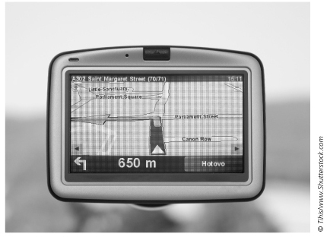
Figure 1-2 GPS on bulldozer

Slide 10
Industry
Warehouse Management examples:
  Forklift trucks can be outfitted with wireless equipment and employees can wear portable wireless inventory devices to scan bar codes
  Warehouse management system (WMS) software manages all warehouse activities
    WMS is tied into network so managers have ready access to up-to-the-minute statistics
  Radio frequency identification (RFID) tags emit a wireless data signal containing an ID number
    Works with WMS to track inventory

Slide 11
Industry
Manufacturing examples:
  RFID tags are often used
  RFID Used for inventory and security

Slide 12
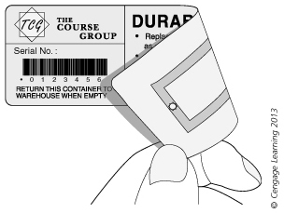
Figure 1-4 RFID tag

Slide 13
Travel
Airlines, commuter rail lines and even ferry boats are now offering wireless data access
Airlines use wireless technology for communication with aircraft and even for flight maintenance
Vehicle-to-vehicle (V2V) communications uses both GPS and wireless to create a network that allows cars to communicate with one another
  Can alert drivers of accidents or traffic hazards ahead of them
  Can also be used to control traffic jams

Slide 14
Public Safety
Public safety departments using WLANs to communicate information with public safety vehicles
  Large volumes of data can be quickly downloaded to vehicles
    e.g., building floor plans, photographs of criminal suspects, and maps

Slide 15
Health Care
Wireless LAN point-of-care computer systems allow medical staff to access and update patient records immediately
  Document patient’s medication administration immediately
  Extensive use of RFID tags
    Identify healthcare professionals, patients, medications
  System verifies that medication being administered to correct patient in correct dosage
    Eliminates potential errors and documentation inefficiencies

Slide 16
Health Care
Documentation process takes place at bedside where care delivered
  Improves accuracy
Hospital personnel have real-time access to latest medication and patient status information
Wireless technology also used in other medical areas:
  e.g., video pills

Slide 17
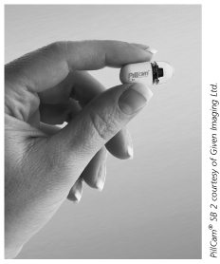
Figure 1-6 Video pill

Slide 18
Wireless Advantages and Disadvantages: Advantages
Mobility: Primary advantage of wireless technology
  Enables individuals to use devices no matter where users roam within range of network
  Increasingly mobile workforce is characteristic of today’s business world
  WLANs give mobile workers freedom while allowing them to access network resources
  “Flatter” organizations: WLANs give team-based workers ability to access network resources needed while collaborating in team environment

Slide 19
Wireless Advantages and Disadvantages: Advantages
Access: wireless can provide network access to areas where previously none existed
  hotspot: Locations where wireless data services are available
  Municipal networks: hotspots typically found in downtown areas, parks and recreation areas and other high-traffic areas
  Advantages of municipal networks:
    More attractive to businesses
    Local police, fire, and municipal workers can use them
    Provide high speed Internet access for free or low cost

Slide 20
Wireless Advantages and Disadvantages: Advantages
Connectivity: Wireless technologies can provide improved service, extend the reach of networks, and provide a less expensive alternative to wired technologies
  Wireless ISP: provides wireless data access directly to the home instead of a cable or DSL provider
  Backhaul connection: an organization’s internal infrastructure connection between two or more remote locations
    Wireless networks can be used eliminating the costs associated with leasing lines or installing fiber optic cables

Slide 21
Wireless Advantages and Disadvantages: Advantages
Deployment: Installing network cabling in older buildings difficult and costly
  Wireless LAN is ideal solution
  Eliminating need for cabling results in cost savings
    Significant time savings as well
  Allows offices to reorganize easily
  Wireless LAN technology eliminates certain types of cable failures and increases overall network reliability

Slide 22
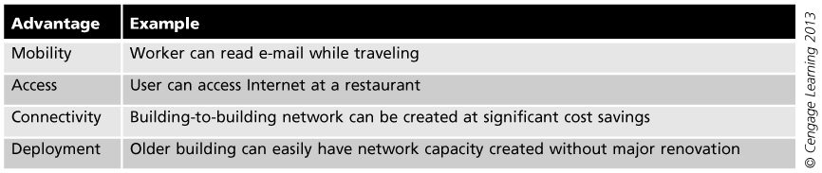
Advantages of wireless data network

Slide 23
Wireless Advantages and Disadvantages: Disadvantages
Security: Wireless signals broadcast in open air
  Security for wireless LANs is prime concern
    Unauthorized users might access network
      Can often pick up signal outside the building
    Attackers might view transmitted data
    Employees could compromise network security
      could install rogue access points
    Attackers could easily crack existing wireless security
      Older wireless products have very weak security features

Slide 24
Wireless Advantages and Disadvantages: Disadvantages
Radio Signal Interference: Signals from other devices can disrupt wireless transmissions
  e.g., Microwave ovens, elevator motors, photocopying machines, theft protection devices, cordless telephones
Range of Coverage: Some wireless signals only have a range of 10 feet while others extend to over 350 feet
Slow Speed: a packet moving through a wireless network is slower than it would be on a wired network

Slide 25
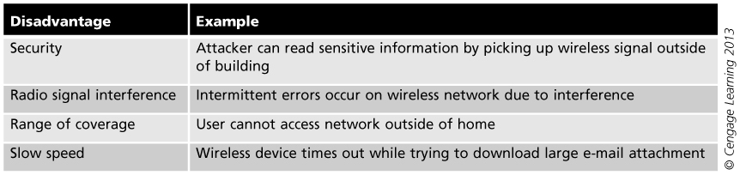
Disadvantages of wireless data network

Slide 26
Wireless Network Risks
Internet-connected devices may be used
by nefarious entities to collect personal information, steal identities, compromise financial data, and silently listen to— or watch— users.
Taking a few precautions in the configuration and use of your devices can help prevent this type of activity

Slide 27
Piggybacking
Failure to secure your wireless network could open your internet connection to many unintended users.
These users may be able to conduct illegal activity, monitor and capture your web traffic, or steal personal files

Slide 28
Wardriving
Wardriving is a specific kind of piggybacking
In this risk, the attacker drive through cities and neighbourhoods with a wireless-equipped computer— sometimes with a powerful antenna— searching for unsecured wireless

Slide 29
Evil Twin Attacks
In this attack, an adversary gathers information about a public network access point, then sets up their system to impersonate it.
The adversary uses a broadcast signal stronger than the one generated by the legitimate access point; then, unsuspecting users connect using the stronger signal.

Slide 30
Evil Twin Attacks Cont.
it’s easy for the attacker to use specialized tools to read any data the victim sends over the internet. This data may include credit card numbers, username and password combinations, and other personal information.
To avoid this attack Always confirm the name and password of a public Wi-Fi hotspot prior to use. This will ensure you are connecting to a trusted access point.

Slide 31
Wireless Sniffing
Many public access points are not secured and the traffic they carry is not encrypted.
This can put your sensitive communications or transactions at risk. Because your connection is being transmitted “in the clear,”
Special tools can obtain sensitive information such as passwords or credit card numbers.
To minimize sniffing attack, all the access points you connect to use at least WPA2 encryption.

Slide 32
Unauthorized Computer Access
An unsecured public wireless network combined with unsecured file sharing could allow a malicious user to access any directories and files you have unintentionally made available for sharing.
Ensure that when you connect your devices to public networks, you deny sharing files and folders.

Slide 33
Theft of Mobile Devices
Physically stealing your device, attackers could have unrestricted access to all of its data, as well as any connected cloud accounts.
To secure you data, use encryptions tools to encrypt your sensitive data
also it is advisable to configure your device’s applications to request login information before allowing access to any cloud-based information.

Slide 34
Internet of Things
Cars, lighting, healthcare, and home security all contain sensing devices that can talk to other machines and trigger additional actions and other tools that track your eating, sleeping, and exercise habits.
This technology provides a level of convenience to our lives but the security of these devices is not always guaranteed

Slide 35
Wireless Standards Organizations and Regulatory Agencies
Several organizations provide direction, standards, and accountability in wireless technology
  International Telecommunication Union Radio Communication Sector (ITU-R)
  Internet Engineering Task Force(IETF)
  International Organization for Standardization (ISO)
  Institute of Electrical and Electronics Engineers (IEEE)
  Federal Communications Commission (FCC)
  Wi-Fi Alliance

Slide 36
International Telecommunication Union Radio Communication Sector (ITU-R)
ITU-R: responsible for global management of the radio frequency spectrum
Develops standards for wireless communications systems
  To ensure most effective use of the radio spectrum

Slide 37
  Internet Engineering Task Force(IETF)
IETF is an international community of people in the networking industry whose goal is to make the Internet work better.
The mission of the IETF, as defined by the organization in a document known as RFC 3935, is “to produce high quality, relevant technical and engineering documents that influence the way people design, use, and manage the Internet in such a way as to make the Internet work better.

Slide 38
(IETF) cont.
These documents include protocol standards, best current practices, and informational documents of various kinds.
”The IETF has no membership fees, and anyone may register for and attend an IETF meeting.
The results of a working group are usually the creation of a document known as a Request for Comments (RFC)

Slide 39
International Organization for Standardization (ISO)
ISO: international body that sets industrial and commercial standards
  Officially not a government entity
ISO identifies needs in business and develops standards to address needs, it is responsible for the creation of the Open Systems Interconnection (OSI) model
Goal: make development, manufacturing, and supply of products and services more efficient, safer, and cleaner
ISO works to make trade between countries easier and fairer

Slide 40
Institute of Electrical and Electronics Engineers (IEEE)
IEEE: most widely know and influential organization in computer networking and wireless communications field
Currently involved in revising over 800 standards
Developers of standards in energy, biomedical, health care, and transportation industries
IEEE standard for WLANs is typically referred to as IEEE 802.11
  Variations of the standard: 802.11g, 802.11n, 802.1af

Slide 41
Federal Communications Commission (FCC)
FCC: serves as the primary regulatory agency for wireless communications in the US ,Includes communications by radio, wire, satellite, and cable
Both licensed and unlicensed communications are typically regulated in the following five areas:
Frequency
Bandwidth
Maximum power of the intentional radiator (IR)
Use (indoor and/or outdoor)
Spectrum sharing rules

Slide 42
Licensed and unlicensed frequencies
Licensed frequencies require an approved license application, and the financial costs are typically very high.
Unlicensed frequency is that permission to transmit on the frequency is free and do not need any approvals.
The main disadvantage to transmitting in an unlicensed frequency band is that anyone else can also transmit in that same frequency space. Unlicensed frequency bands are often very crowded; therefore, transmissions from other individuals can cause interference with your transmissions. For that, unlicensed frequency has a limited range.

Slide 43
Wi-Fi Alliance
Initially known as the Wireless Ethernet Compatibility Alliance (WECA) – formed in 1999
Had three goals:
  Encourage wireless manufacturers to use the IEEE WLAN technologies
  Promote and market these technologies
  Test and certify that wireless products adhere to the IEEE standards to ensure interoperability

Slide 44
Wi-Fi Alliance
In Oct. 2002 – WECA changed name to Wi-Fi (Wireless Fidelity) Alliance
Only devices that have passed Wi-Fi Alliance testing are allowed to refer to their products as
Wi-Fi Certified (registered trademark)

Slide 45
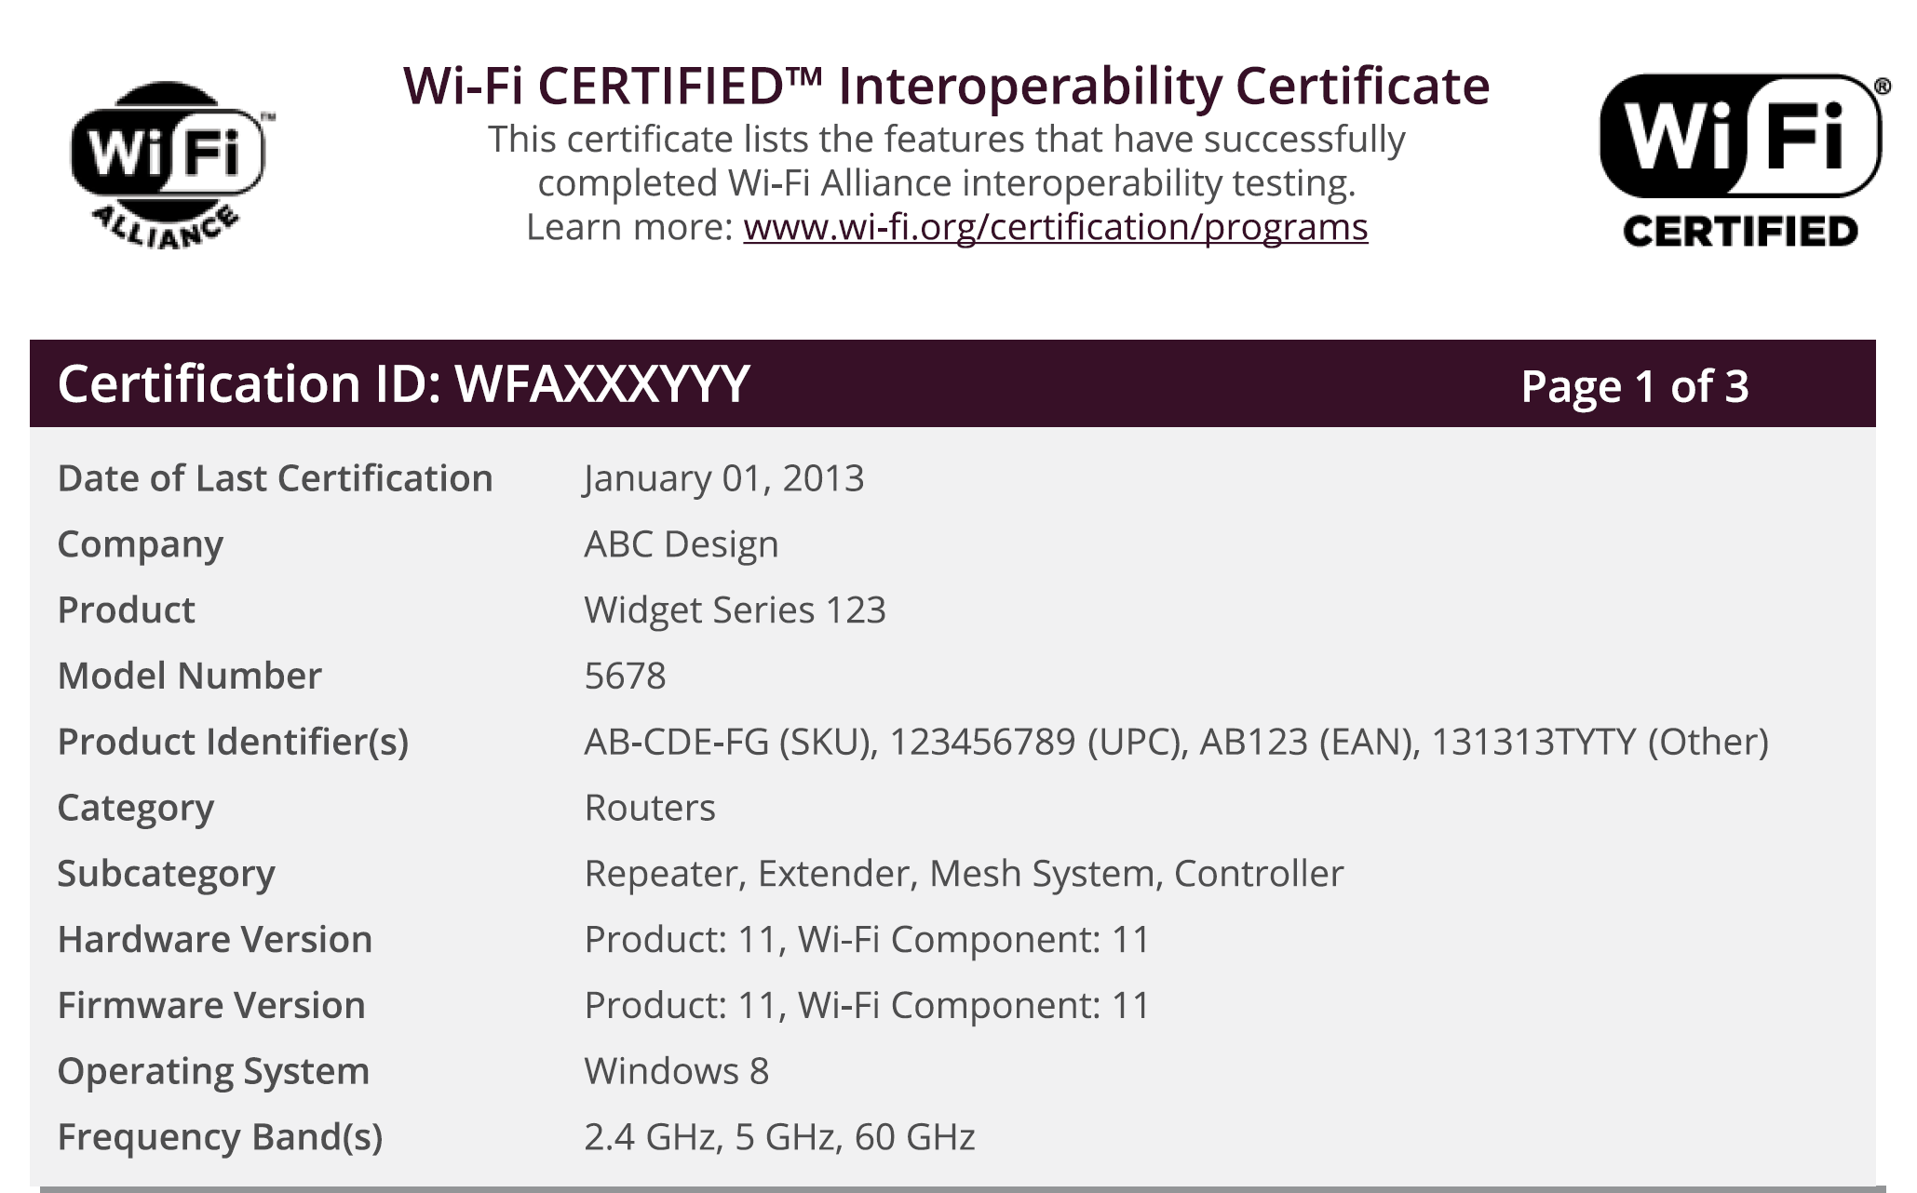

Slide 46
